Slide 1


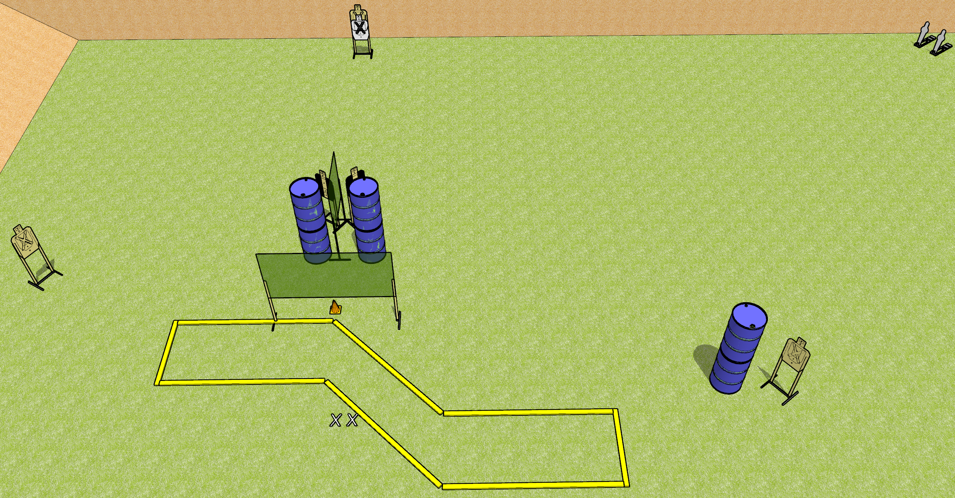
 | Dothan Gun Club – USPSA Match Long Shots Course Designer : Drew Coleman
START POSITION : Standing with both feet on X’s, wrists below belt
GUN READY CONDITION : Pistol loaded and holstered. PCC loaded, shouldered, safety on, pointed at orange cone. |  | SCORING: Comstock, 12 rounds TARGETS: 5 paper, 2 Steel SCORED HITS: Best 2 on paper, steel until down START-STOP: Audible, last shot RULES:
STAGE PROCEDURE: Engage targets as they become available from within the fault lines.

Slide 2
Long Shots
Written Stage Briefing
Long Shots is a 12 round, 60 point, Comstock short course. There are five USPSA targets and two mini poppers. The best two hits on paper will score, and steel must fall to score. The start signal is audible.
Handgun start position is standing with both feet on X’s, hands relaxed at sides. Handgun is loaded and holstered.
PCC start position is standing with both feet on X’s, muzzle pointed at orange cone. Loaded carbine is held with both hands, shouldered, safety on.
On start signal, engage targets as they become available from within the fault lines.

Slide 3
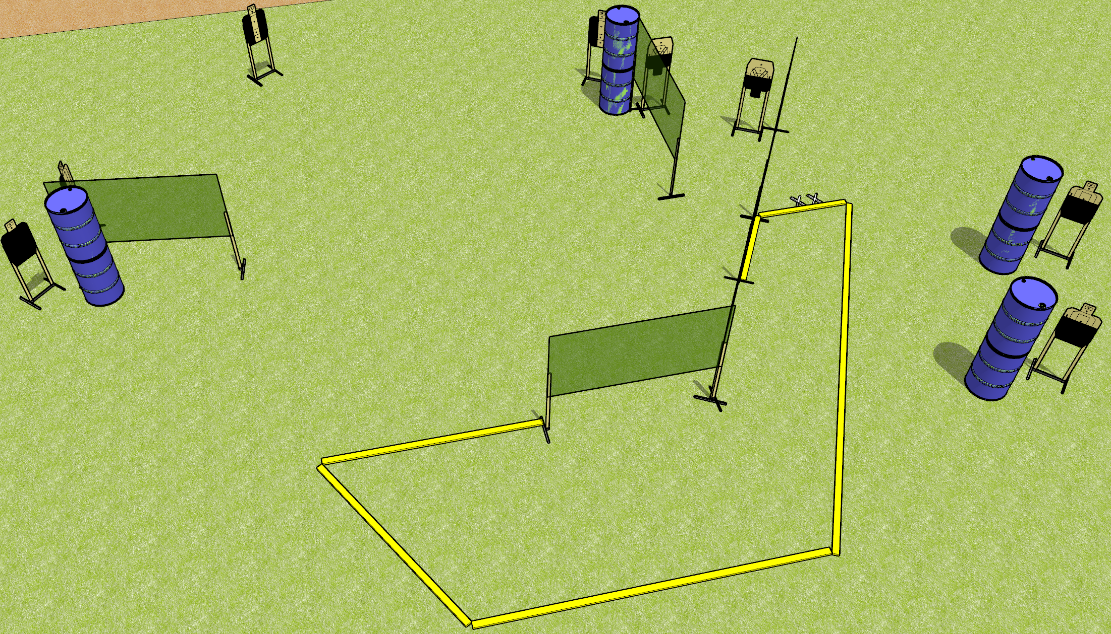
 | Dothan Gun Club – USPSA Match Partials Everywhere! Course Designer : Drew Coleman
START POSITION : Standing with both feet on X’s, heels against (not on) fault line, wrists below belt
GUN READY CONDITION : Pistol loaded and holstered. PCC loaded, shouldered, safety on, pointed at orange cone. |  | SCORING: Comstock, 16 rounds TARGETS: 8 paper, 0 Steel SCORED HITS: Best 2 on paper, steel until down START-STOP: Audible, last shot RULES:
STAGE PROCEDURE: Engage targets as they become available from within the fault lines.

Slide 4
Partials Everywhere!
Written Stage Briefing
Partials Everywhere! is a 16 round, 80 point, Comstock medium course. There are eight USPSA targets. The best two hits on paper will score. The start signal is audible.
Handgun start position is standing with both feet on X’s, heels against but not on top of the fault line. Handgun is loaded and holstered.
PCC start position is standing with both feet on X’s, heels against but not on top of the fault line. Loaded carbine held with both hands, shouldered, safety on, pointed at orange cone.
On start signal, engage targets as they become available from within the shooting area.

Slide 5
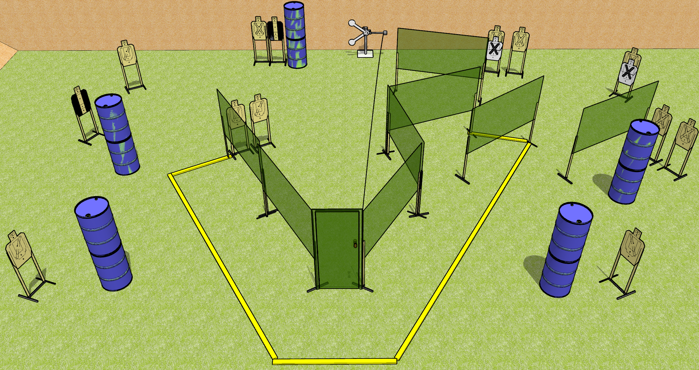
 | Dothan Gun Club – USPSA Match Brian’s Boogie Course Designer : Drew Coleman
START POSITION : Weak hand touching door handle, strong wrist below belt.
GUN READY CONDITION : Pistol loaded and holstered. PCC loaded, held with strong hand, safety on, pointed in a safe direction. |  | SCORING: Comstock, 28 rounds TARGETS: 13 paper, 2 Steel SCORED HITS: Best 2 on paper, steel until down START-STOP: Audible, last shot RULES:
STAGE PROCEDURE: Engage targets as they become available from within the fault lines.

Slide 6
Brian’s Boogie
Written Stage Briefing
Brian’s Boogie is a 28 round, 140 point, Comstock field course. There are thirteen USPSA targets and two falling plates. The best two hits on paper will score. Steel must fall to score. The start signal is audible.
Handgun start position is in the shooting area with weak hand touching door handle. Handgun is loaded and holstered.
PCC start position is in the shooting area with weak hand touching door handle. Loaded carbine is held with strong hand, safety on, pointed in a safety direction.
Upon start signal, engage targets as they become available from within the shooting area. The swinging target is activated by opening the door. It may be engaged prior to activation, but must be activated before last shot fired.

Slide 7
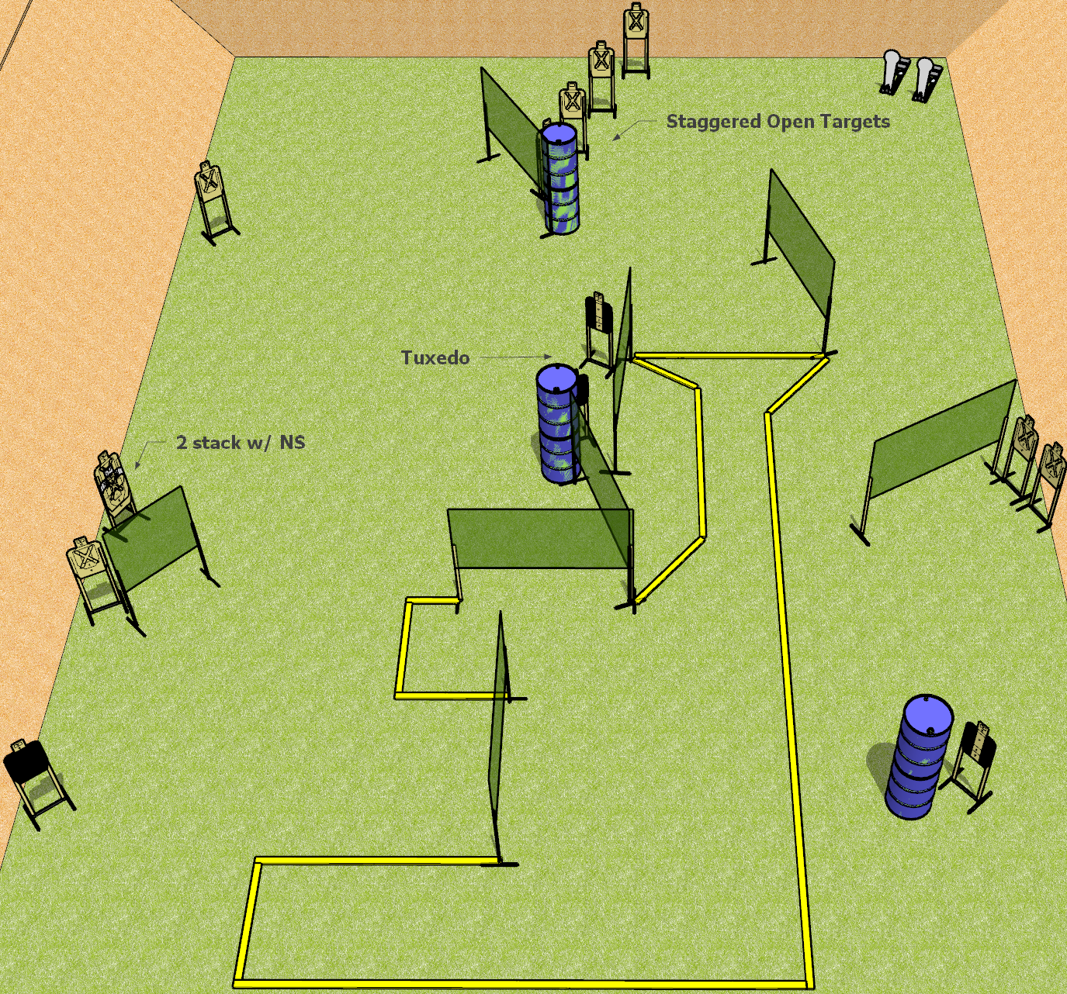
 | Dothan Gun Club – USPSA Match Top of the Funnel Course Designer : Drew Coleman
START POSITION : Standing anywhere inside the shooting area, wrists below belt
GUN READY CONDITION : Pistol loaded and holstered. PCC loaded, buttstock on belt, safety on, pointed in a safe direction. |  | SCORING: Comstock, 30 rounds TARGETS: 14 paper, 2 Steel SCORED HITS: Best 2 on paper, steel until down START-STOP: Audible, last shot RULES:
STAGE PROCEDURE: Engage targets as they become available from within the fault lines.

Slide 8
Top of the Funnel
Written Stage Briefing
Top of the Funnel is a 30 round, 150 point, Comstock Field course. There are fourteen USPSA targets and two colt poppers. The best two hits on paper will score, and steel must fall to score. The start signal is audible.
Handgun start position is standing anywhere inside the shooting area, wrists below belt. Handgun is loaded and holstered.
PCC start position is standing anywhere inside the shooting area, muzzle pointed in a safe direction. Loaded carbine is held with both hands, safety on, buttstock on belt.
On start signal, engage targets as they become available from within the fault lines.

Slide 9
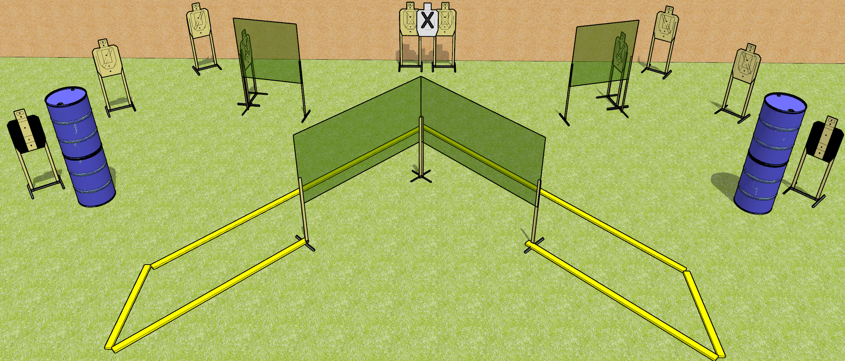
 | Dothan Gun Club – USPSA Match Shoot all the Things! Course Designer : Drew Coleman
START POSITION : Standing straddling the leftmost or right most fault line, wrists above shoulders.
GUN READY CONDITION : Pistol loaded and holstered. PCC loaded, buttstock on belt, safety on, muzzle perpendicular to the back berm. |  | SCORING: Comstock, 30 rounds TARGETS: 10 paper, 0 Steel SCORED HITS: Best 3 on paper, steel until down START-STOP: Audible, last shot RULES:
STAGE PROCEDURE: Engage targets as they become available from within the fault lines.

Slide 10
Shoot All the Things!
Written Stage Briefing
Shoot all the Things! is a 30 round, 150 point, Comstock field courses. There are ten USPSA targets. The best three hits on paper will score. The start signal is audible.
Handgun start position is standing straddling the leftmost or rightmost fault line with wrists above respective shoulders. Handgun is loaded and holstered.
PCC start position is standing straddling the leftmost or rightmost fault line, muzzle perpendicular to the back berm. Loaded carbine is held with both hands, safety on, buttstock on belt.
Upon start signal, engage targets as they become available from within the fault lines.

Slide 11
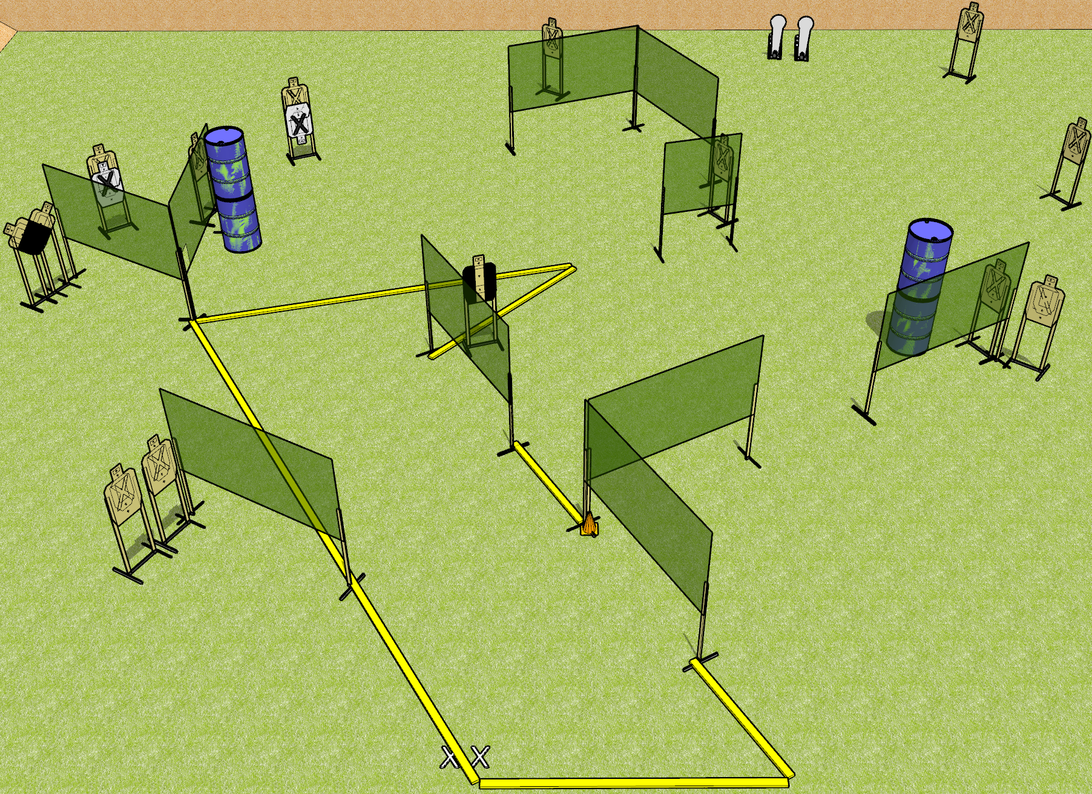
 | Dothan Gun Club – USPSA Match Pickaxe Course Designer : Drew Coleman
START POSITION : Standing with both feet on X’s, wrists below belt
GUN READY CONDITION : Pistol loaded and holstered. PCC loaded, shouldered, safety on, pointed at orange cone. |  | SCORING: Comstock, 30 rounds TARGETS: 14 paper, 2 Steel SCORED HITS: Best 2 on paper, steel until down START-STOP: Audible, last shot RULES:
STAGE PROCEDURE: Engage targets as they become available from within the fault lines.

Slide 12
Pickaxe
Written Stage Briefing
Pickaxe is a 30 round, 150 point, Comstock field course. There are fourteen USPSA targets and two colt poppers. The best two hits on paper will score, and steel must fall to score. The start signal is audible.
Handgun start position is standing with both feet on X’s, wrists below belt. Handgun is loaded and holstered.
PCC start position is standing with both feet on X’s, muzzle pointed at orange cone. Carbine loaded, held with both hands, safety on, shouldered.
Upon start signal, engage targets as they become available from within the shooting area.
Setup note: steel at 20 yards

Slide 13
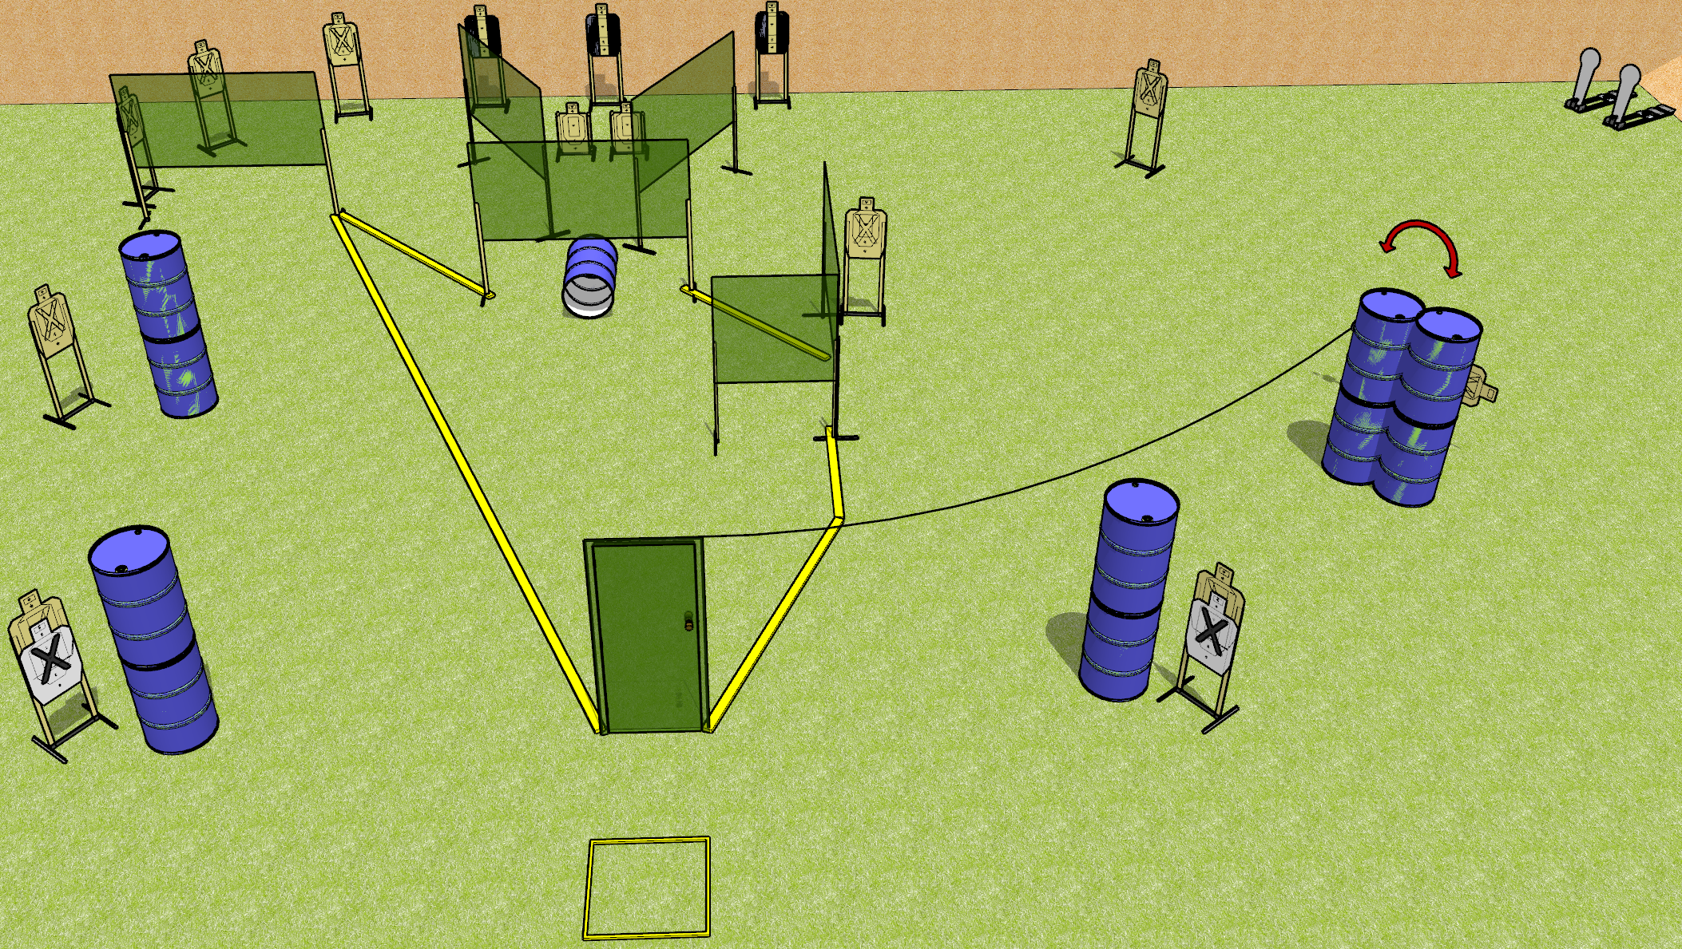
 | Dothan Gun Club – USPSA Match Low Blow Course Designer : Drew Coleman
START POSITION : Standing in start box, wrists above shoulders.
GUN READY CONDITION : Pistol loaded and holstered. PCC loaded, buttstock on belt, safety on, pointed in a safe direction. |  | SCORING: Comstock, 30 rounds TARGETS: 14 paper, 2 Steel SCORED HITS: Best 2 on paper, steel until down START-STOP: Audible, last shot RULES:
STAGE PROCEDURE: Engage targets as they become available from within the fault lines.

Slide 14
Low Blow
Written Stage Briefing
Low Blow is a 30 round, 150 point, Comstock field course. There are fourteen USPSA targets and two Colt poppers. The best two hits on paper will score, and steel must fall to score. The start signal is audible.
Handgun start position is standing in start box with wrists above respective shoulders. Handgun is loaded and holstered.
PCC start position is standing in start box with buttstock on belt, muzzle pointed in a safe direction. Loaded carbine is held with both hands, safety on.
Upon start signal, engage targets as they become available from within the fault lines. The swinging target is activated by opening the door and it is visible at rest.

Slide 15
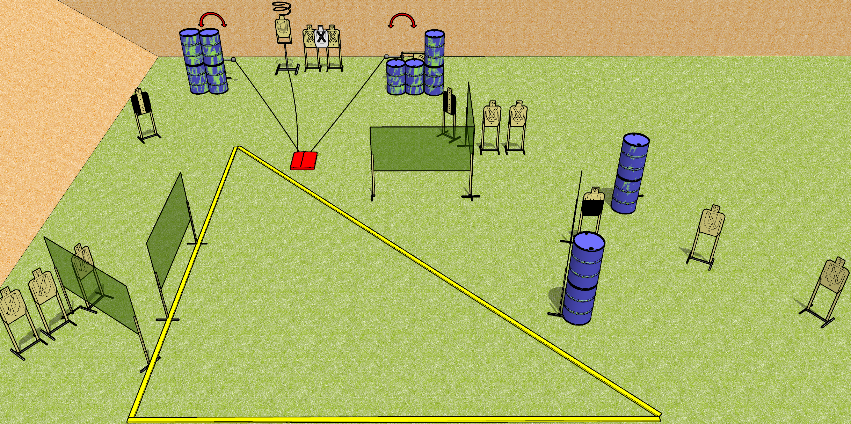
 | Dothan Gun Club – USPSA Match Geometry Course Designer : Drew Coleman
START POSITION : Standing in shooting area, wrists above shoulders
GUN READY CONDITION : Pistol loaded and holstered. PCC loaded, buttstock on belt, safety on, pointed in a safe direction. |  | SCORING: Comstock, 32 rounds TARGETS: 16 paper, 0 Steel SCORED HITS: Best 2 on paper, steel until down START-STOP: Audible, last shot RULES: Drop turner is a disappearing target
STAGE PROCEDURE: Engage targets as they become available from within the fault lines.

Slide 16
Geometry
Written Stage Briefing
Geometry is a 32 round, 160 point, Comstock field course. There are sixteen USPSA targets. The best two hits on paper will score. The start signal is audible. The stomp box will activate both swingers and the drop turner. The drop turner is a disappearing target, and will be the last target in the tablet.
Handgun start position is standing in the shooting area, wrists above shoulders. Handgun is loaded and holstered.
PCC start position is standing in the shooting area, buttstock touching belt. Carbine is loaded, held with both hands, safety on, pointed in a safe direction.
On start signal, engage the targets from within the shooting area.

Slide 17
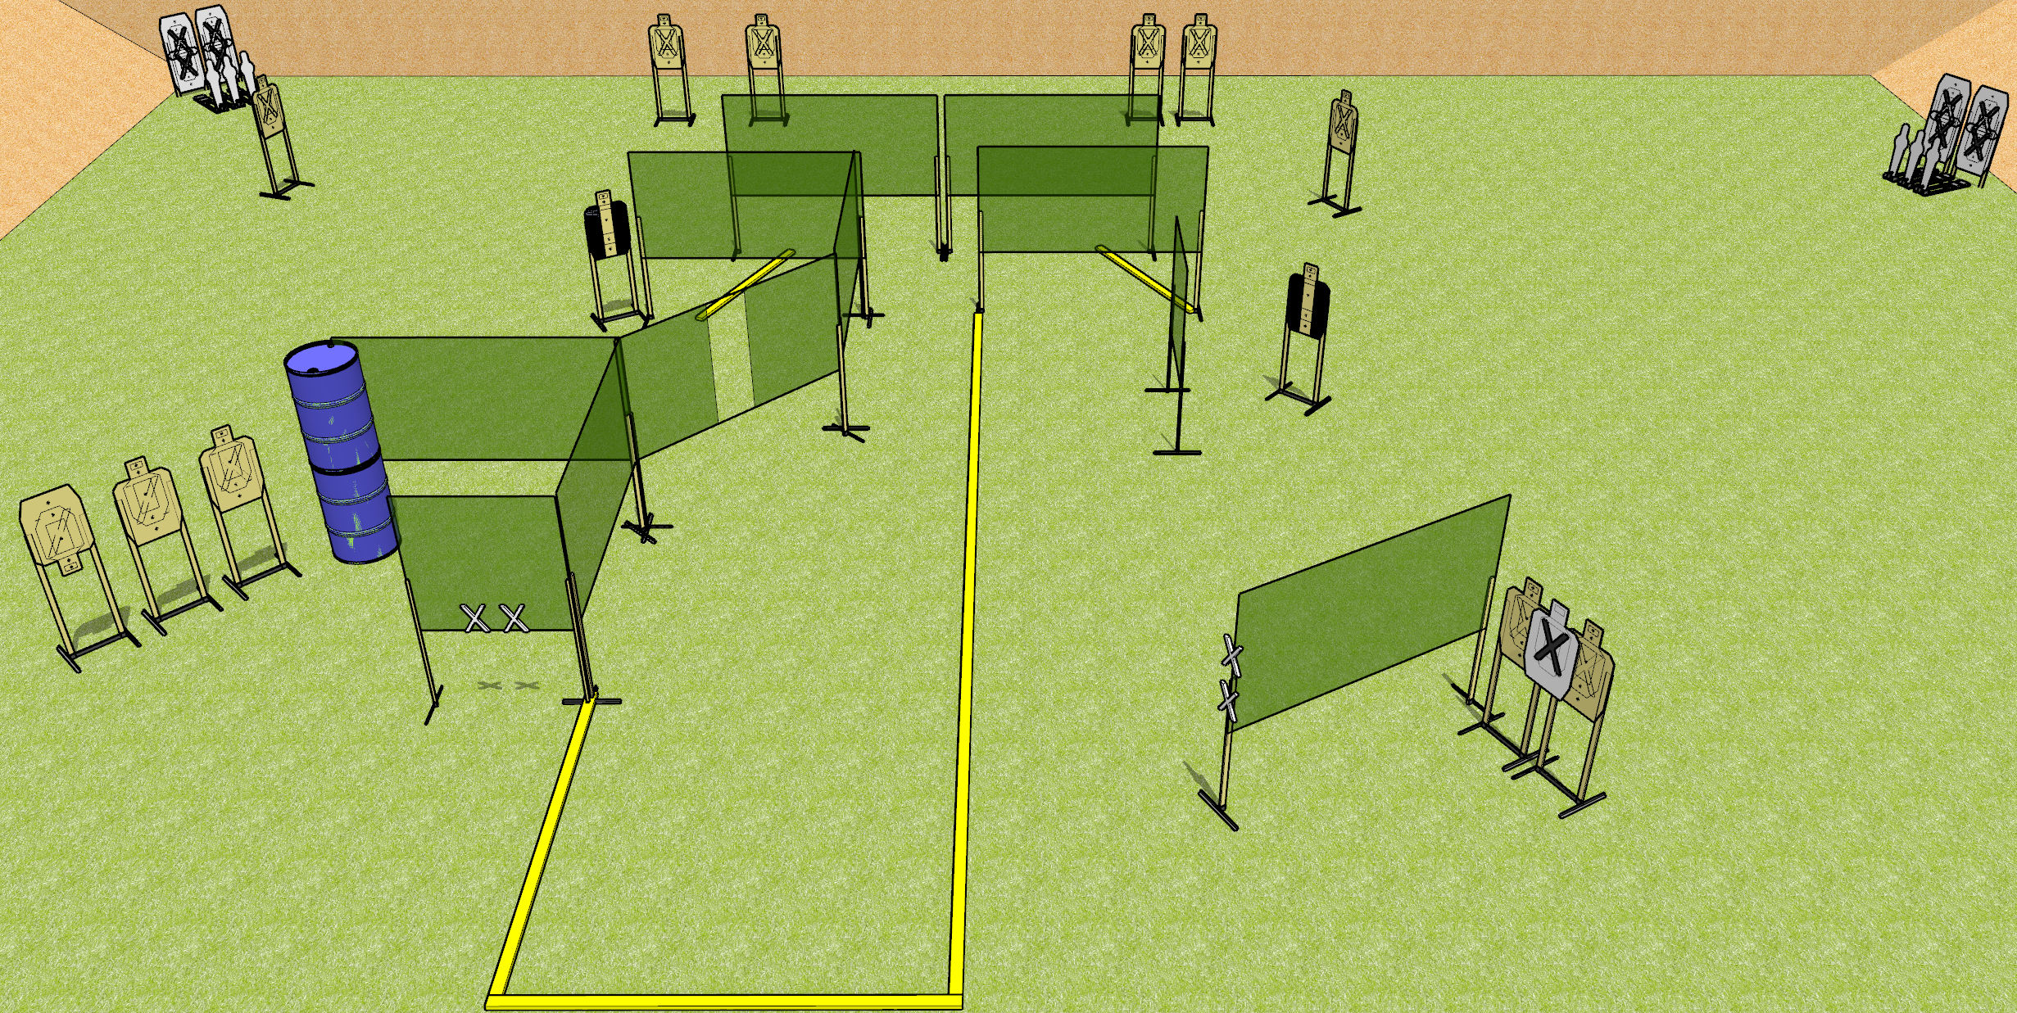
 | Dothan Gun Club – USPSA Match Drew’s an Asshole Course Designer : Drew Coleman
START POSITION : completely outside the shooting area not touching fault lines, both hands touching marks. PCC muzzle touching any mark.
GUN READY CONDITION : Pistol loaded and holstered. PCC loaded, shouldered, held with both hands, safety on, muzzle touching a mark. |  | SCORING: Comstock, 32 rounds TARGETS: 13 paper, 6 Steel SCORED HITS: Best 2 on paper, steel until down START-STOP: Audible, last shot RULES:
STAGE PROCEDURE: Engage targets as they become available from within the fault lines.

Slide 18
Drew’s an Asshole
Written Stage Briefing
Drew’s an Asshole is a 32 round, 160 point, Comstock field course. There are thirteen USPSA targets and six mini poppers. The best two hits on paper will score, and steel must fall to score. The start signal is audible.
Handgun start position is standing completely outside the shooting area, not touching any fault lines, hands touching either set of marks. Handgun is loaded and holstered
PCC start position is standing completely outside the shooting area, not touching any fault lines, muzzle touching any mark. Loaded carbine is held with both hands, safety on, shouldered.
Upon start signal, engage targets as they become available from within the shooting area. You may curse Drew and his no-shoots after the range has been called clear.

Slide 19
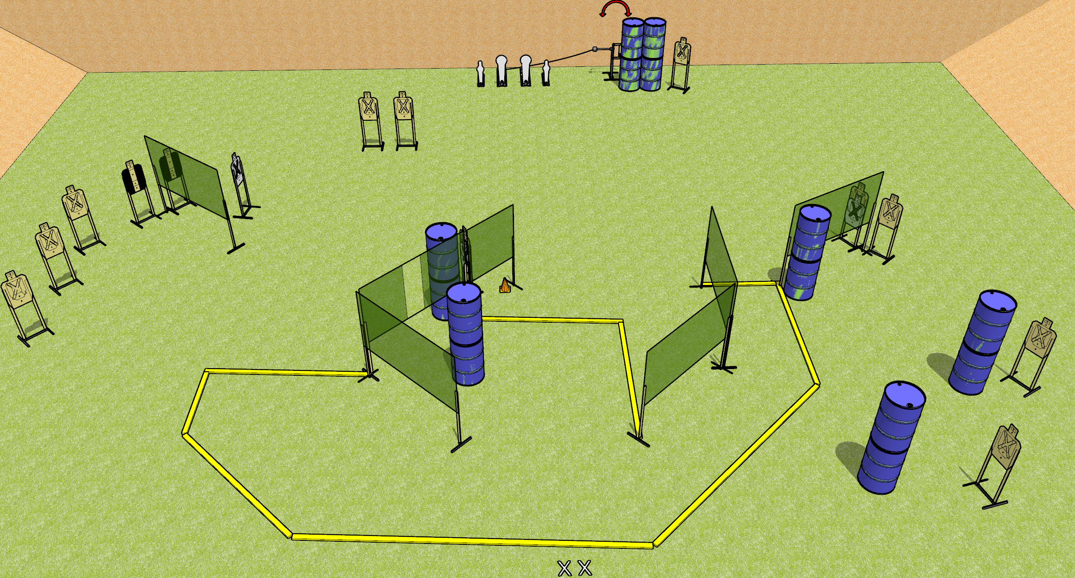
 | Dothan Gun Club – USPSA Match Single Stack Friendly Course Designer : Drew Coleman
START POSITION : Standing with both feet on X’s, wrists below belt
GUN READY CONDITION : Pistol loaded and holstered. PCC loaded, shouldered, safety on, pointed at orange cone. |  | SCORING: Comstock, 32 rounds TARGETS: 14 paper, 4 Steel SCORED HITS: Best 2 on paper, steel until down START-STOP: Audible, last shot RULES:
STAGE PROCEDURE: Engage targets as they become available from within the fault lines.

Slide 20
Single Stack Friendly
Written Stage Briefing
Single Stack Friendly is a 32 round, 160 point, Comstock field course. There are fourteen USPSA targets, two Colt poppers, and two mini poppers. The best two hits on paper will score, and steel must fall to score. The start signal is audible.
The swinger is activated by either Colt popper. Check the activator setup prior to activating during walkthrough and reset it the same way each time.
Handgun start position is standing with both feet on X’s, wrists below belt. Handgun is loaded and holstered.
PCC start position is standing with both feet on X’s. Loaded carbine is held with both hands, shouldered, safety on, pointed at orange cone.
On start signal, engage targets from within the fault lines.

Slide 21
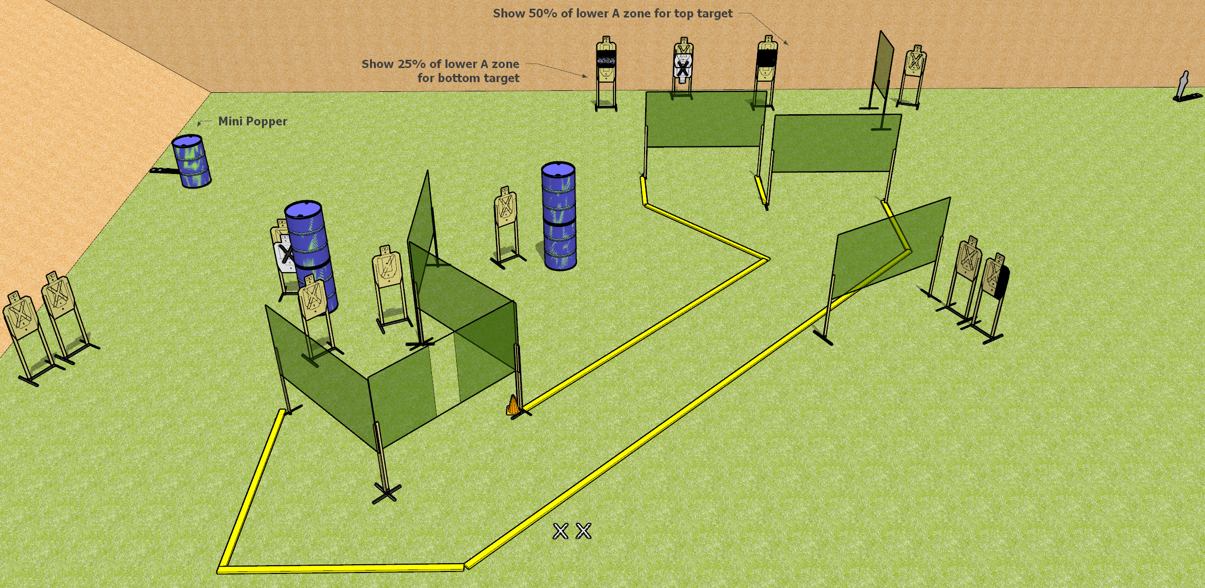
 | Dothan Gun Club – USPSA Match Hose ‘em Down Course Designer : Drew Coleman
START POSITION : Standing with both feet on X’s, wrists below belt
GUN READY CONDITION : Pistol loaded and holstered. PCC loaded, shouldered, safety on, pointed at orange cone. |  | SCORING: Comstock, 32 rounds TARGETS: 15 paper, 2 Steel SCORED HITS: Best 2 on paper, steel until down START-STOP: Audible, last shot RULES:
STAGE PROCEDURE: Engage targets as they become available from within the fault lines.

Slide 22
Hose ‘em Down
Written Stage Briefing
Hose ‘em Down is a 32 round, 160 point, Comstock field course. There are fifteen USPSA targets and two mini poppers. The best two hits on paper will score, and steel must fall to score. The start signal is audible.
Handgun start position is standing with feet on X’s, wrists below belt. Handgun is loaded and holstered.
PCC start position is standing with feet on X’s, muzzle pointed at orange cone. Loaded carbine is held with both hands, safety on, shouldered.
On start signal, engage targets from within the shooting area.

Slide 23
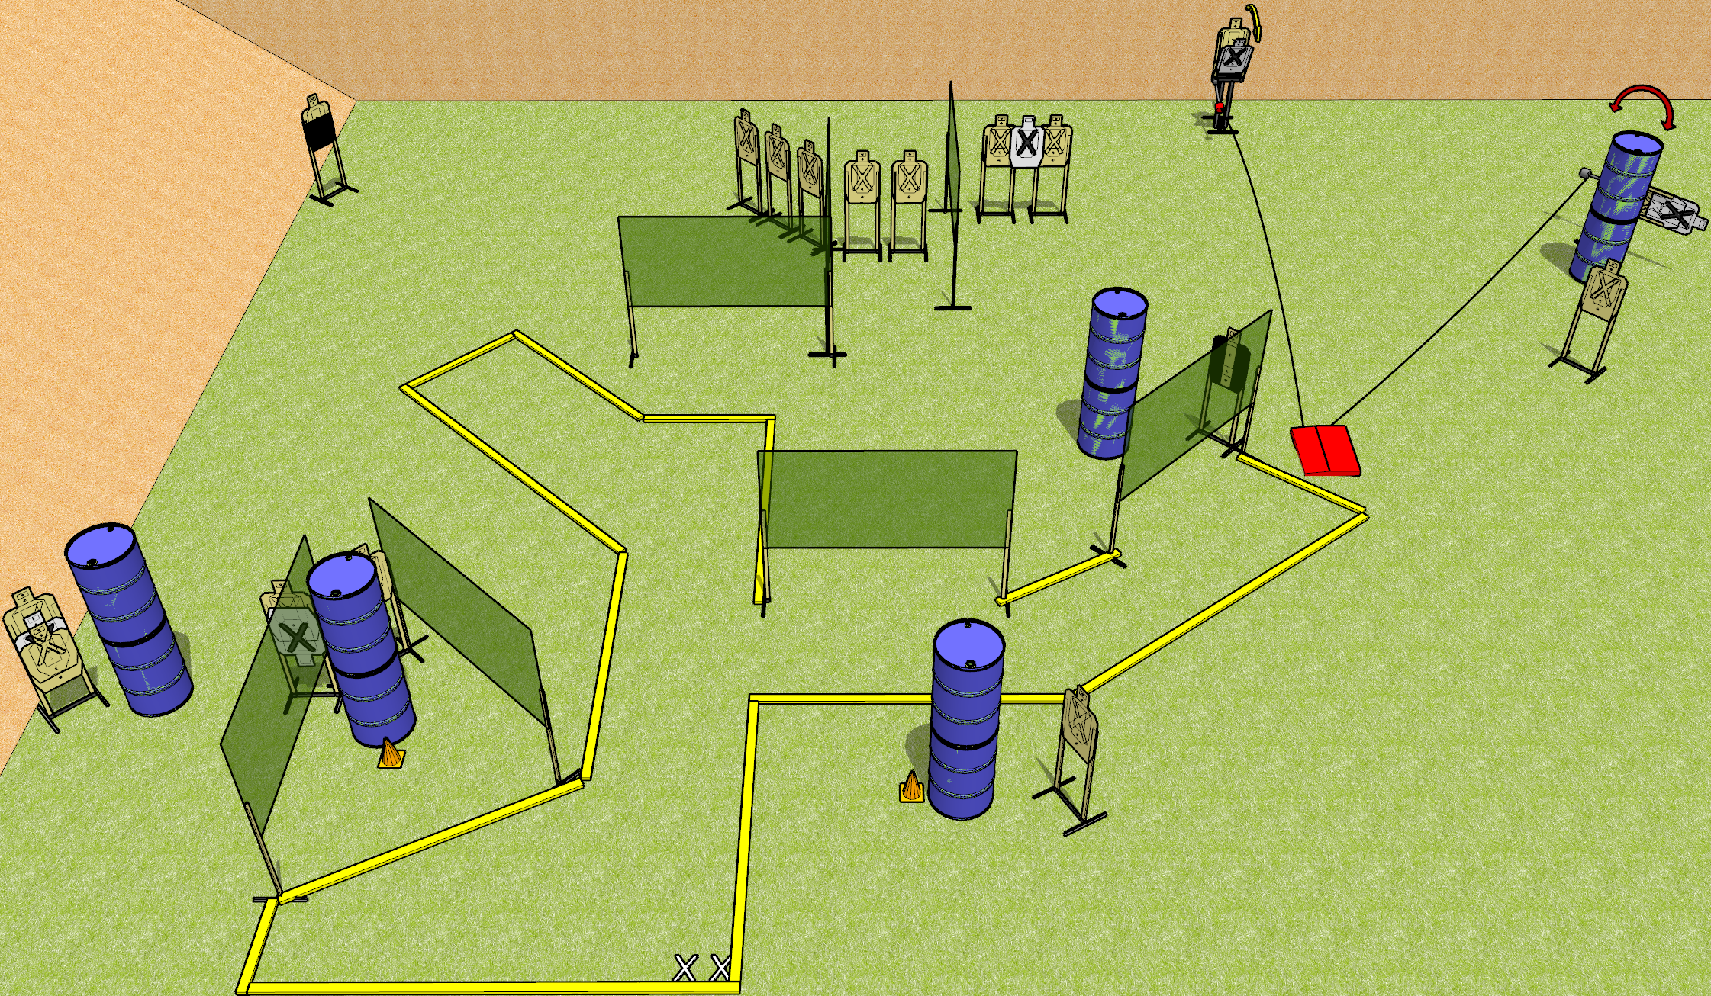
 | Dothan Gun Club – USPSA Match Three Piece Course Designer : Drew Coleman
START POSITION : Standing with both feet on X’s, wrists below belt
GUN READY CONDITION : Pistol loaded and holstered. PCC loaded, shouldered, safety on, pointed at either orange cone. |  | SCORING: Comstock, 34 rounds TARGETS: 17 paper, 0 Steel SCORED HITS: Best 2 on paper, steel until down START-STOP: Audible, last shot RULES: both moving targets must be activated before being engaged, and neither are disappearing targets.
STAGE PROCEDURE: Engage targets as they become available from within the fault lines.

Slide 24
Three Piece
Written Stage Briefing
Three Piece is a 34 round, 170 point, Comstock field course. There are seventeen USPSA targets. The best two hits on paper will score. The start signal is audible.
Handgun start position is standing with both feet on X’s, wrists below belt. Handgun is loaded and holstered.
PCC start position is standing with both feet on X’s, muzzle aimed at either orange cone. Loaded carbine is held with both hands, safety on, shouldered.
Upon start signal, engage the targets as they become available. The stomp pad will activated the max trap and the swinger. Both targets are available at rest, and must be activated before being engaged.

